Slide 1
Stock Market Prediction(Seminar)
17BIT055 Mufaddal Naya

Slide 2
COMPRESSION TECHNIQUES

Slide 3
The two Types of compression techniques are:
Lossless compression
Lossy compression

Slide 4
Lossless compression:
As the name implies, lossless compression involves no loss of any kind of information.
Generally used for applications that can’t tolerate any kind of information loss.
Important areas for lossless compression are text compressions.
If data of any kind are to be processed or “enhanced” later to yield more information, it is important that the integrity be preserved and that is why texts are compressed using Lossless compression techniques.

Slide 5
Lossy Compression:
These types of compression involve some loss of information.
The data which is lost generally cannot be recovered.
Instead of this, we can generally obtain much higher compression
ratios.
JPEG images and GIFs are compressed using lossy compression techniques.
Videos are also compressed using lossy methods.

Slide 6
LOSSY
An advantage is that it outputs very small compressed file sizes and there are a lot of tools, plugins and softwares that support Lossy compression.
A drawback is that the quality of the file compressed is degraded with higher compression ratios.
LOSSLESS
The advantage of this method is that it provides us with no loss of information for eg. banks always use lossless methods for compression.
Drawback is that the compressed file size is larger than the compressed file size in lossy compressions.

Slide 7
Huffman Algorithm

Slide 8
Compression Part

Slide 9
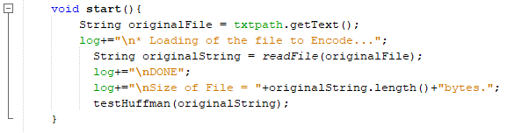
start()
readFile(String fname)
testHuffman(String originalString)

Slide 10
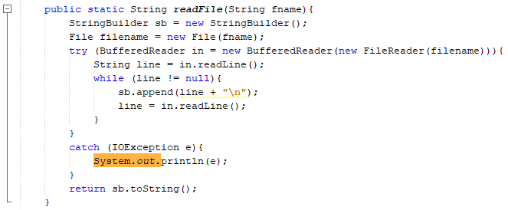
readFile(String)
Back

Slide 11
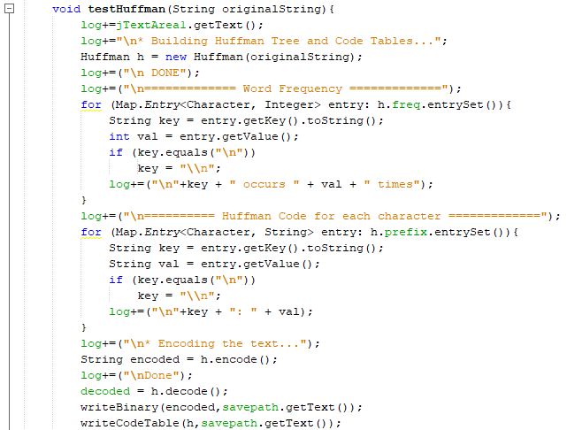
testHuffman(String)
Huffman(String)
encode()
decode()
writeBinary(String, String)
writeCodeTable(Huffman, String)
Next

Slide 12
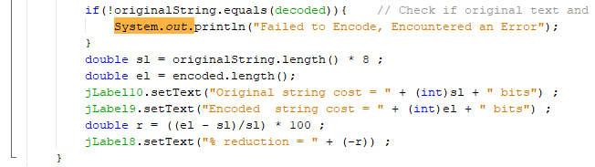
testHuffman(String)

Slide 13
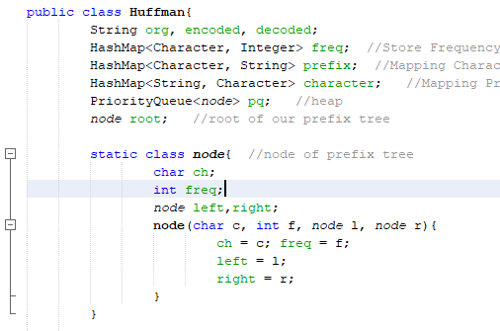
Huffman Initialization
Next

Slide 14
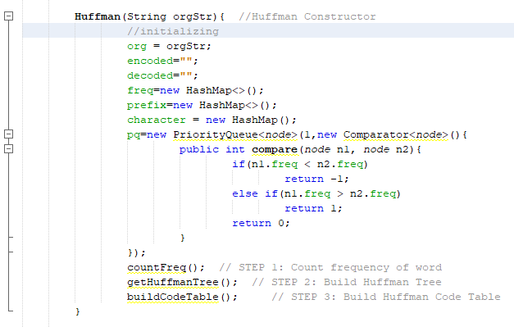
Huffman(String)
countFreq()
getHuffmanTree()
buildCodeTable()
Back

Slide 15
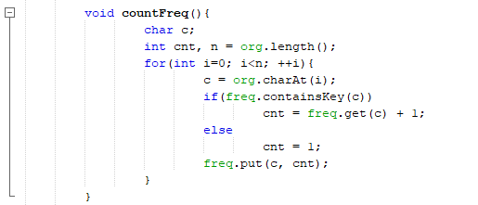
countFreq()
Back

Slide 16
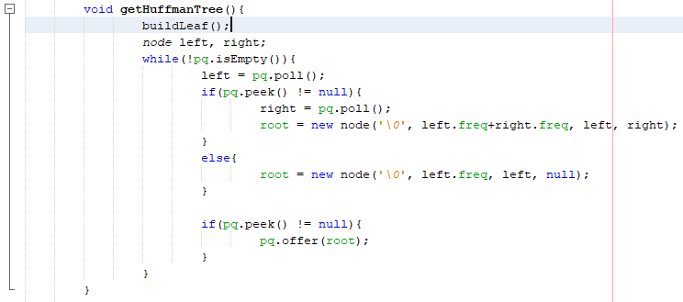
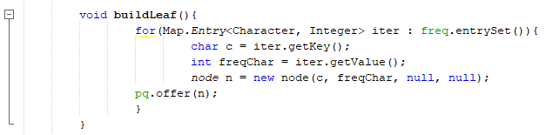
getHuffmanTree()
Back

Slide 17
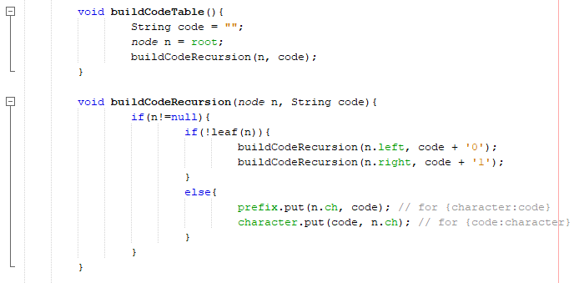
buildCodeTable()
Back

Slide 18
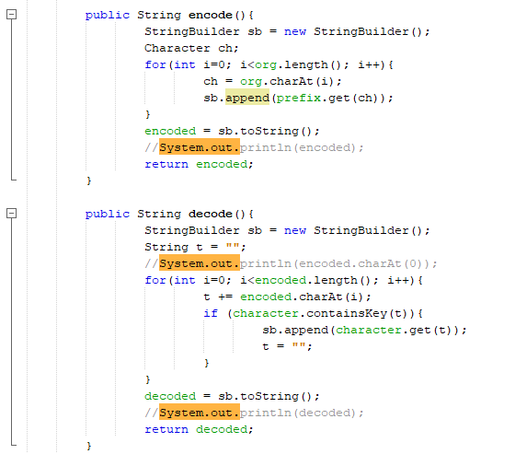
encode() & decode()
Back

Slide 19
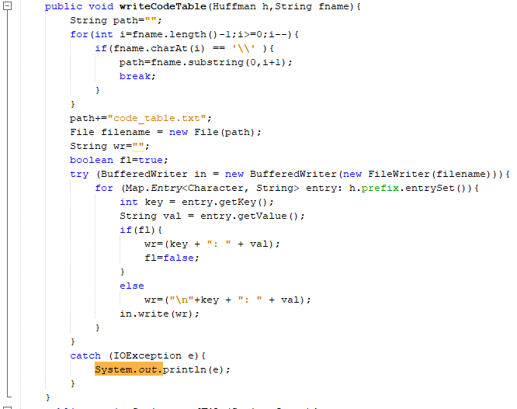
writeCodeTable(Huffman, String)
Back

Slide 20
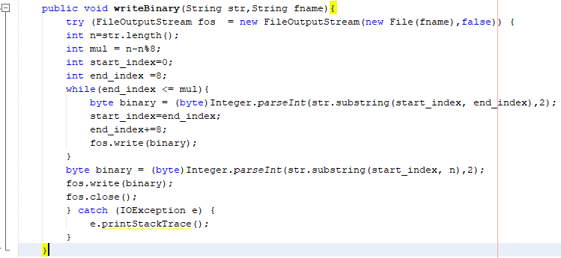
writeBinary(String, String)
Back

Slide 21
Decompression Part

Slide 22
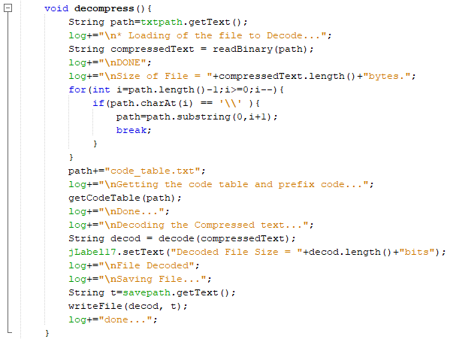
decompress()
readBinary(String)
getCodeTable(String)
decode(String)
writeFile(String, String)

Slide 23
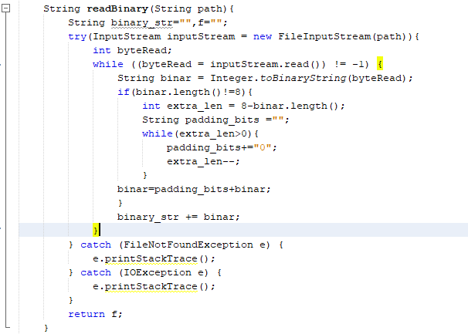
readBinary(String)
Back

Slide 24
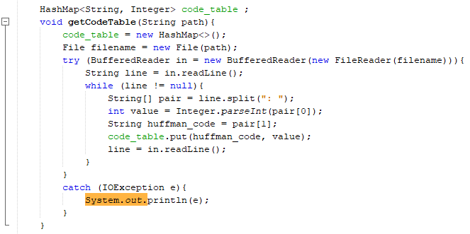
getCodeTable(String)
Back

Slide 25
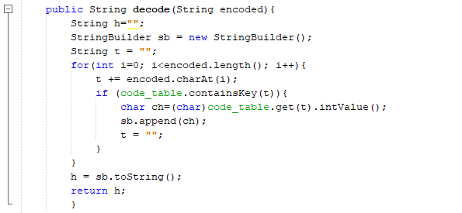
decode(String)
Back

Slide 26
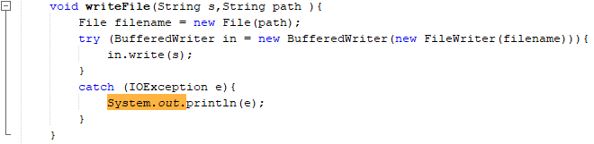
writeFile(String, String)
Back

Slide 27
Applications of Huffman Encoding:
Huffman encoding is used for text compression because text compression is a compression which is to be done by lossless compression techniques.
Data which is stored in banks have to be compressed using lossless because any ..
bank data manipulated can cost hundreds and thousands of loss.
Huffman encoding along with LZ77 encoding can also be used for text compression where this method is called the DEFLATE algorithm.

